Slide 1
CSE 519: Data Science
Steven Skiena
Stony Brook University
Lecture 6: Assembling Data Sets

Slide 2
Data Munging
Good data scientists spend most of their time cleaning and formatting data.
The rest spend most of their time complaining there is no data available.
Data munging or data wrangling is the art of acquiring data and preparing it for analysis.

Slide 3
Languages for Data Science
Python: contains libraries and features (e.g regular expressions) for easier munging.
R: programming language of statisticians.
Matlab: fast and efficient matrix operations.
Java/C: language for Big Data systems.
Mathematica/Wolfram Alpha: symbolic math.
Excel: bread and butter tool for exploration.

Slide 4
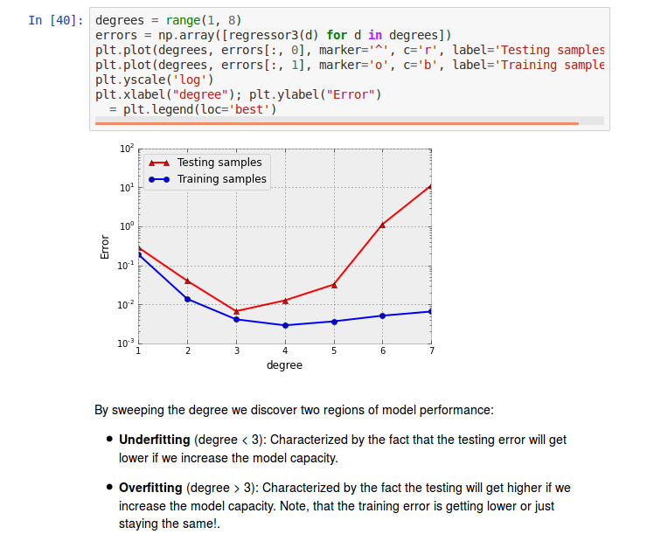
Notebook Environments
Mixing code, data, computational results, and text are essential for projects to be:
reproducible
tweakable
documented.

Slide 5


Data Pipelines
Notebooks make it easier to maintain data pipelines, the sequence of processing steps from start to finish.
Expect to have to redo your analysis from scratch, so build your code to make it possible.

Slide 6
Standard Data Formats
Historically, computer scientists would rather share a toothbrush than a data format.
But accepted standards are now available:
CSV files: for tables like spreadsheets
XML: for structured but non-tabular data.
JSON: Javascript Object Notation for APIs.
SQL databases: for multiple related tables.

Slide 7
Where Does Data Come From?
The critical issue in any modelling project is finding the right data set.
This will certainly be the case for your projects!
Large data sets often come with valuable metadata: e.g. book titles, image captions, Wikipedia edit history...
Repurposing metadata requires imagination.

Slide 8
Sources of Data
Proprietary data sources
Government data sets
Academic data sets
Web search
Sensor data
Crowdsourcing
Sweat equity
https://toolbox.google.com/datasetsearch

Slide 9
Proprietary Data Sources
Facebook, Google, Amazon, Blue Cross, etc. have exciting user/transaction/log data sets.
Most organizations have/should have internal data sets of interest to their business.
Getting outside access is usually impossible.
Companies sometimes release rate-limited APIs, including Twitter and Google.

Slide 10
Government Data Sources
City, State, and Federal governments are increasingly committed to open data.
Data.gov has over 100,000 open data sets!
The Freedom of Information Act (FOI) enables you to ask if something is not open.
Preserving privacy is often the big issue in whether a data set can be released.

Slide 11
Academic Data Sets
Making data available is now a requirement for publication in many fields.
Expect to be able to find economic, medical, demographic, and meteorological data if you look hard enough.
Track down from relevant papers, and ask.
Google topic and “Open Science” or “data”

Slide 12
Web Search/Scraping
Scraping is the fine art of stripping text/data from a webpage.
Libraries exist in Python to help parse/scrape the web, but first search:
Are APIs available from the source?
Did someone previously write a scraper?
Terms of service limit what you can legally do.

Slide 13
Available Data Sources
Bulk Downloads: e.g. Wikipedia, IMDB, Million Song Database.
API access: e.g. New York Times, Twitter, Facebook, Google.
Be aware of limits and terms of use.

Slide 14
Sensor Data Logging
The “Internet of Things” can do amazing things:
Image/video data can do many things: e.g. measuring the weather using Flicker images.
Measure earthquakes using accelerometers in cell phones.
Identify traffic flows through GSP on taxis.
Build logging systems: storage is cheap!

Slide 15
Crowdsourcing
Many amazing open data resources have been built up by teams of contributors:
Wikipedia/Freebase
IMDB
Crowdsourcing platforms like Amazon Turk enable you to pay for armies of people to help you gather data, like human annotation.

Slide 16
Sweat Equity
But sometimes you must work for your data instead of stealing it.
Much historical data still exists only on paper or PDF, requiring manual entry/curation.
At one record per minute, you can enter 1,000 records in only two work days.
Often projects require sweat equity.

Slide 17
Project Data Sources
Miss Universe?
Movie gross?
Baby weight?
Art auction price?
Snow on Christmas?
Super Bowl / College Champion?
Ghoul Pool?
Future Gold / Oil Price?

Slide 18
Cleaning Data: Garbage In, Garbage Out
問題:
區分錯誤
統一性
計算missing value
估計未觀察到的數
Outlier 偵測

Slide 19
Errors vs. Artifacts
The key to detecting artifacts is the sniff test

Slide 20
First-time Scientific Authors by Year?
In a bibliographic study, we analyzed PubMed data to identify10萬個最常被引用的作者的首次發表時間。
What should the distribution of new top authors by year look like?
It is important to have a 偏見 of any result to help detect異常

Slide 21
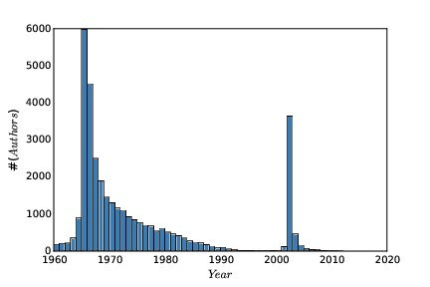
Might this be Right?
A student once tried to foist this off on me.
What artifacts do you see?
What possible explanations could cause them?

Slide 22
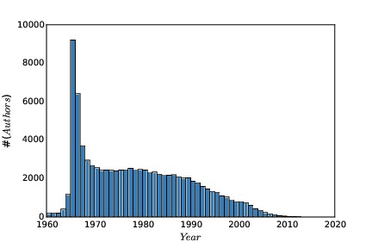
Mystery Solved!
Pubmed used author first names starting in 2002.
SS Skiena became
Steven S Skiena
Data cleaning gets rid of such artifacts.

